Slide 1

Unit 16 – Procedural Programming
with Ben Read

Slide 2
AIMS & OBJECTIVES
Comprehend operator types in C –
Arithmetical
Logical
Relational
Understand mathematical precedence
Apply these techniques to your calculator

Slide 3
OPERATORS
Arithmetical Operators –
+
-
*
/
%
++
--

Slide 4
OPERATORS
Dividing (/) integers does not return a fraction. Any remainder is discarded resulting in a whole number rounded down.
The % symbol returns the remainder of a division, e.g.
int a = 21;
int b = 10;
int c;
c = a % b;
printf(" The remainder of 21 / 10 = %d\n", c);
The answer is ‘1’.

Slide 5
INCREMENT/DECREMENT
The increment operator (++) adds one to a variable, and the decrement operator (--) subtracts 1. A feature of these operators are that they can be both prefix and postfix operators, that is they can go before or after the variable they are changing, e.g.
my_int = my_int + 1; // normal addition
++my_int; // increment with prefix operator
my_int++; // increment with postfix operator

Slide 6
COMPOUND ASSIGNMENTS
Compound Operators are shortcuts –
+=
-=
*=
/=
%=

Slide 7
COMPOUND ASSIGNMENT
All of the operators have a shortcut notation called the compound assignment. All this means is that instead of using:
my_int = my_int + 25;
my_float_1 = my_float_1 / my_float_2;
You can use the shortcuts
my_int += 25; // same as my_int = my_int + 25;
my_float_1 /= my_float_2; // same as my_float_1 = my_float_1 / my_float_2;

Slide 8
EQUALITY OPERATORS
There are two binary equality operators –
EQUAL TO (==)
NOT EQUAL TO (!=)
These are used to compare two values and return a boolean value of 0 or 1, true or false, e.g.
int a = 10;
int b = 10;
if (a == b)
{
printf(“Both A and B are equal to %d”, a);
}

Slide 9
RELATIONAL OPERATORS
Other Relational Operators include –
LESS THAN <
GREATER THAN >
LESS THAN OR EQUAL <=
GREATER THAN OR EQUAL >=

Slide 10
LOGICAL OPERATORS
AND = &&
if (a && b) // && is an AND operator and requires both values to be non-zero
{
printf("Neither a or b is zero\n");
}

Slide 11
LOGICAL OPERATORS
OR = ||
if (a || b) // || is an OR operator and requires either value to be non-zero
{
printf("One or both of a and b have a value other than zero\n");
}

Slide 12
LOGICAL OPERATORS
NOT = !
if (!(a && b)) // ! is a NOT operator and reverses the meaning of the following operator
{
printf("One or both integers are zero\n");
}

Slide 13
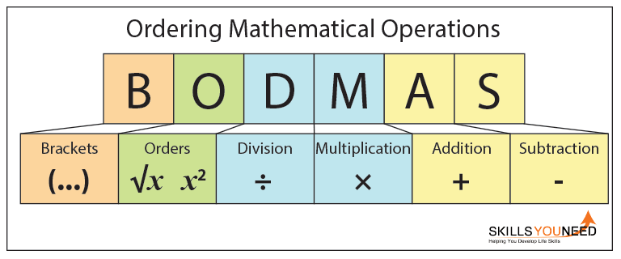
PRECEDENCE
BODMAS –
Brackets

Slide 14
PRECEDENCE
BODMAS is a useful acronym that lets you know which order to solve mathematical problems (or sums). It's important that you follow the rules of BODMAS as without it your answers can be wrong.
The BODMAS acronym is for:
Brackets (parts of a calculation inside brackets always come first).
Orders (numbers involving powers or square roots).
Division.
Multiplication.
Addition.
Subtraction.

Slide 15
PRECEDENCE
Brackets –
Start with anything inside brackets, going from left to right.
Example:
4 × (3 + 2) = ?
You need to do the operation, or sum, inside the brackets first, 3 + 2, then multiply the answer by 4.
3 + 2 = 5. 4 × 5 = 20
If you ignored the brackets and did the sum 4 × 3 + 2 you would get 14. You can see how the brackets make a difference to the answer.

Slide 16
PRECEDENCE
Orders –
Do anything involving a power or a square root next (these are also known as orders), again working from left to right if there is more than one.
Example:
3² + 5 = ?
You need to do the power sum first, before you can add 5.
3² = 3 × 3 = 9 9 + 5 = 14

Slide 17
PRECEDENCE
Division and Multiplication –
Once you have done any parts of the sum involving brackets or powers the next step is division and multiplication.
Multiplication and division rank equally, so you go from left to right in the sum, doing each operation in the order in which it appears.
Example:
4 × 5 ÷ 2 + 7 = ?
You need to do division and multiplication first, but you have one of each.
Start from the left and work across to the right, which means that you start with 4 × 5 = 20. Then do the division, 20 ÷ 2 = 10.
Only then do you move to the addition: 10 + 7 = 17. The answer is 17.

Slide 18
PRECEDENCE
Addition and Subtraction –
The final step is to calculate any addition or subtraction. Again, subtraction and addition rank equally, and you simply move from left to right.
Example:
4 + 6 - 7 + 3 = ?
You simply start on the left and work your way across.
4 + 6 = 10 10 - 7 = 3 3 + 3 = 6 The answer is 6.

